Slide 1
Kinetic simulation of disease transmission
Max Curie

Slide 2
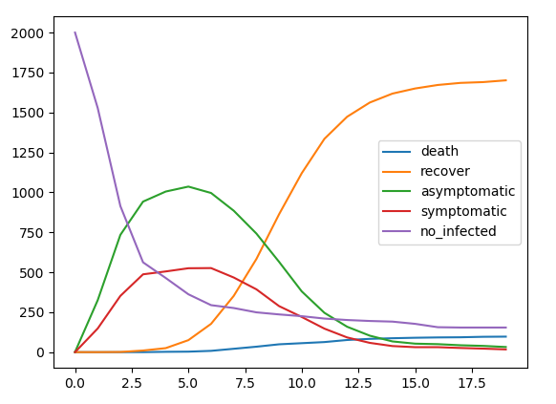
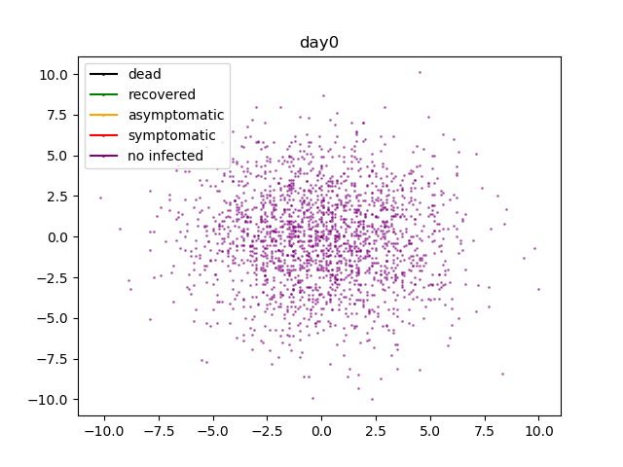
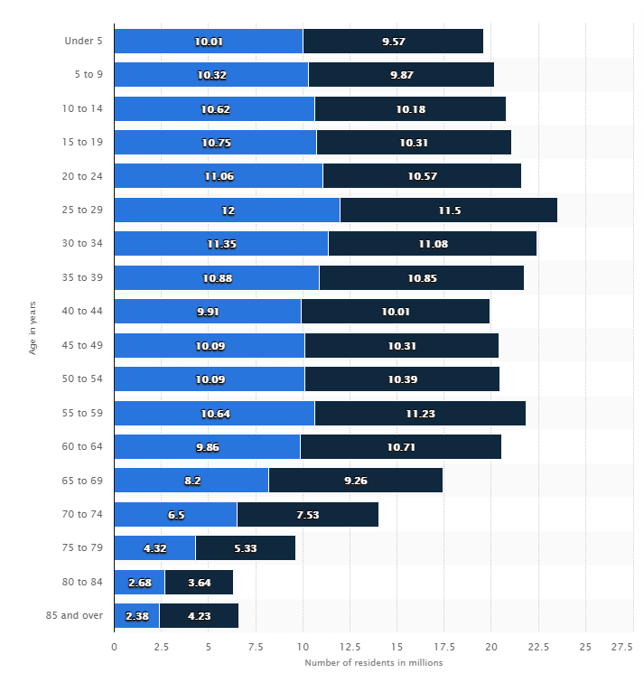
Kinetic simulation

Slide 3
Work options during the Hackathon
Analyze data set from CDC for age distribution of the disease
Realistic density distribution
Age distribution(death, asymptomatic, symptomatic)
Modeling commute
Analyze data for indirect impact of COVID
Traveling, moving(mobility)
Mental health
Physical health not related to COVID
Propose strategy for future plague prevention
And more!

Slide 4
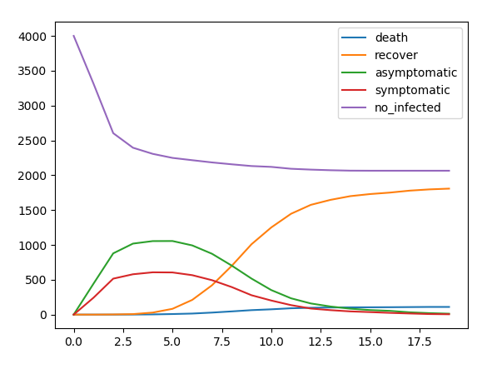
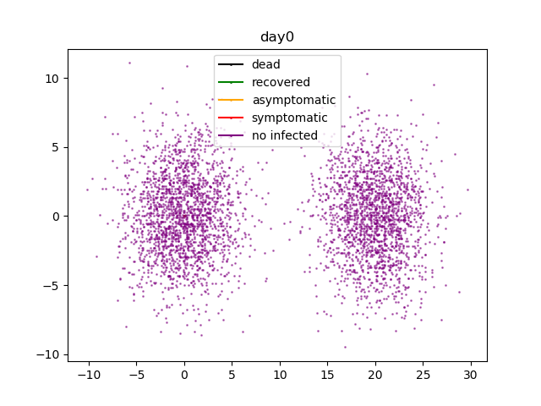

Slide 5
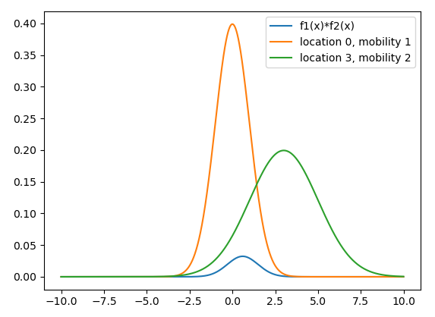
Cross section calc

